Slide 1
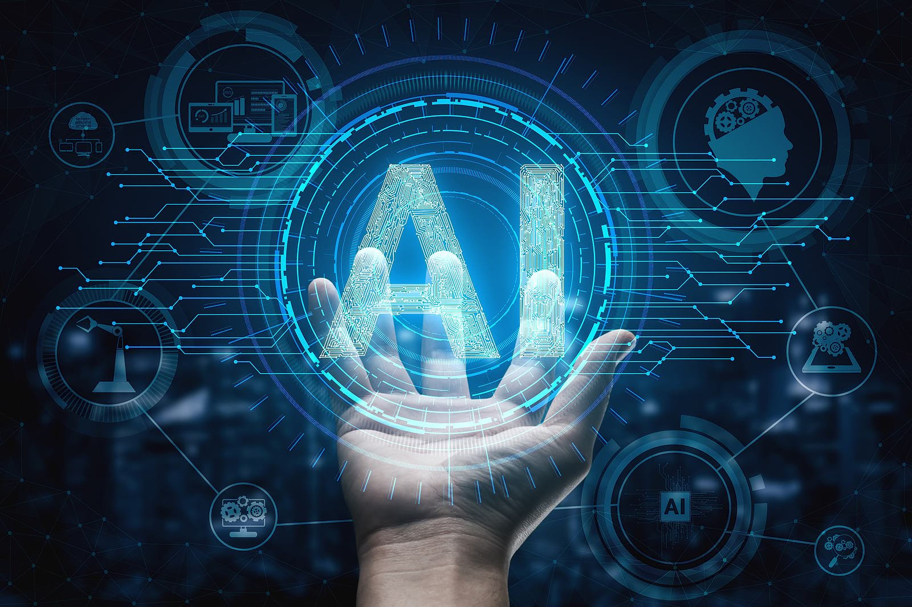
Module 6 ARTIFICIAL INTELLIGENCE
BY: Mohammad Tahir Mirji

Slide 2

Agenda
Basic Concept of
Artificial Intelligence
Deep Dive into Machine
Artificial Intelligence
Learn the application
of AI in
Healthcare
Government
Manufacturing
Finance
Retail
Social Media
The Necessity of Learning AI
Understanding Intelligence
What is Intelligence?
Types of Intelligence
Introduction to Neural Networks
Artificial Neural Network (ANN)
Convolution Neural Network (CNN)
Recurrent Neural Network (RNN)
Deep learning
Cognitive computing
Natural Language processing
Computer vision

Slide 3
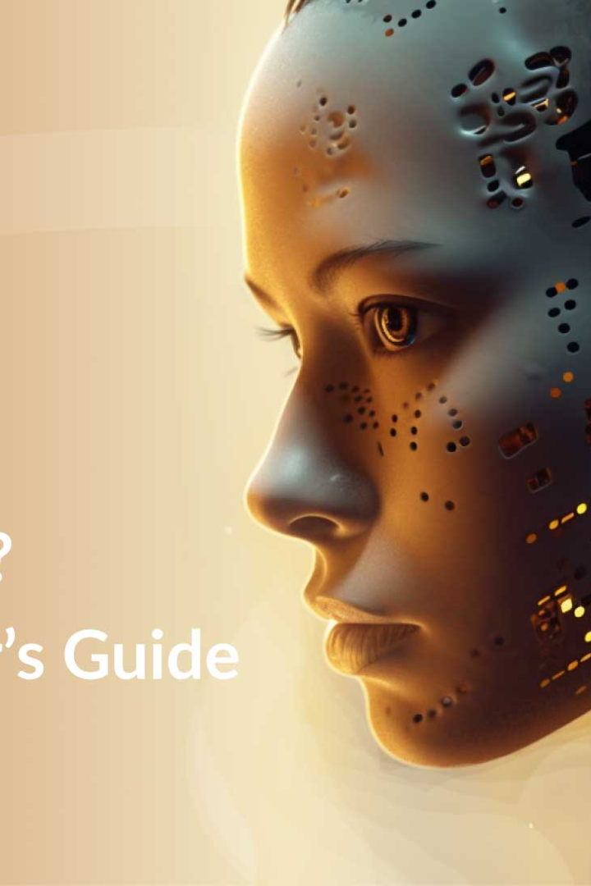
Introduction to Artificial Intelligence
Artificial Intelligence (AI) is the ability of computers to learn and solve problems, improving on their own from past experiences to act intelligently and help solve real-world problems.
AI enables machines to learn, adapt, and perform tasks faster than humans, making our lives easier. In this presentation, we will understand the basic concepts of AI and its different types.

Slide 4
Basic Concept of Artificial Intelligence
Intelligence: The ability to learn and solve problems.
The most common answer that one expects is “to make computers intelligent so that they can act intelligently.
If the computers can, somehow, solve real-world problems, by improving on their own from past experiences, they would be called “intelligent”.
Thus, the AI systems are more generic(rather than specific), can “think” and are more flexible.
Intelligence, as we know, is the ability to acquire and apply knowledge.
Knowledge is the information acquired through experience.
Experience is the knowledge gained through exposure(training)
Summing the terms up, we get artificial intelligence as the “copy of something natural(i.e., human beings) ‘WHO’ is capable of acquiring and applying the information it has gained through exposure.”

Slide 5
The Necessity of Learning AI
Enabling Innovation
AI provides opportunities for innovation with its ability to help businesses better understand consumers' needs and preferences, which can help in target marketing and customer satisfaction. This leads to the creation of new products and services.
1
2
3
Enhancing Efficiency
Ongoing Advancements
AI is known to perform tasks much faster than humans, making machines a great asset to the workforce and creating numerous opportunities for businesses to achieve greater efficiency in their operations.
AI's capabilities continue to evolve and improve, and learning AI today can help us prepare for the advancements to come and stay ahead of the competition.

Slide 6
Understanding Intelligence
Definition
The Importance of AI
AI's Limitations
Artificial Intelligence simulates human intelligence and abilities. It includes learning, reasoning, and self-correction by utilizing the advancements in machine learning to improve computer systems.
AI is important as it enables machines to make our lives easier by performing tasks quicker and more efficiently than humans. Robotics and IoT devices create opportunities for AI to provide significant contributions to various industries.
AI isn't designed to replace humans; it's intended for significant human enhancement and contribution. The breakthroughs in machine learning indicate a significant increase in complex data tasks that require human intervention and neural creativity, which AI currently lacks.

Slide 7
What is Intelligence? Let’s Discuss…
Machines that mimic human intelligence to perform tasks and can iteratively improve themselves based on the information they collect. AI manifests in a number of forms.
Intelligence, as we know, is the ability to acquire and apply knowledge. Knowledge is the information acquired through experience. Experience is the knowledge gained through exposure(training). Summing the terms up, we get artificial intelligence as the “copy of something natural(i.e., human beings) ‘WHO’ is capable of acquiring and applying the information it has gained through exposure.”
AI is much more about the process and the capability for super powered thinking and data analysis than it is about any particular format or function. Although AI brings up images of high-functioning, human-like robots taking over the world, AI isn’t intended to replace humans. It’s intended to significantly enhance human capabilities and contributions. That makes it a very valuable business asset.

Slide 8
Types of Artificial Intelligence
There are other types of A.I. the more tech-oriented crowd observes.
Artificial narrow intelligence (ANI), which has a narrow range of abilities;
Artificial general intelligence (AGI), which is on par with human capabilities; or
Artificial superintelligence (ASI), which is more capable than a human.
Artificial narrow intelligence (ANI), also referred to as weak AI or narrow AI, is the only type of artificial intelligence we have successfully realized to date.
Narrow AI is goal-oriented, designed to perform singular tasks - i.e. facial recognition, speech recognition/voice assistants, driving a car, or searching the internet - and is very intelligent at completing the specific task it is programmed to do.

Slide 9
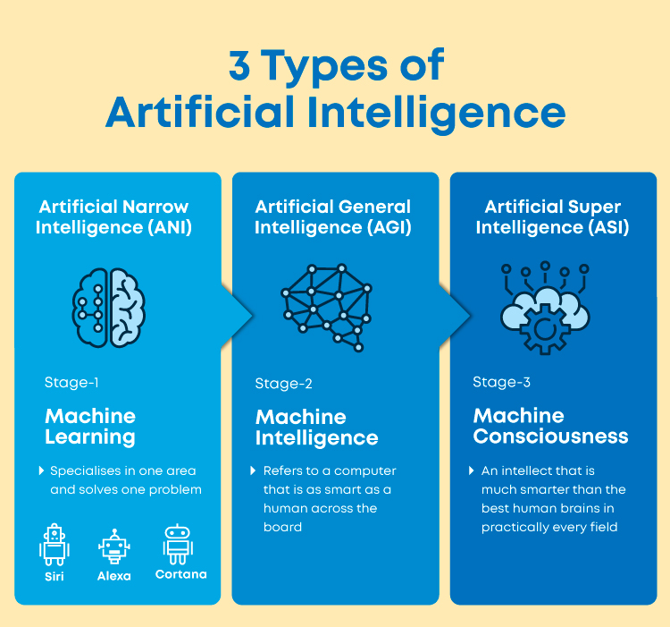

Slide 10
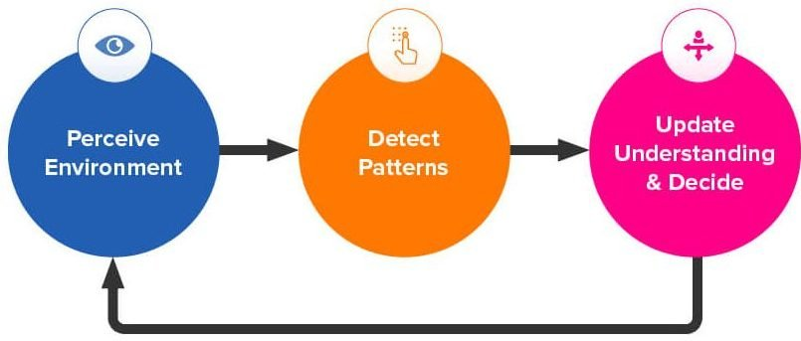
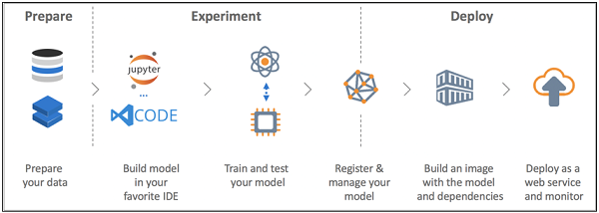

Slide 11
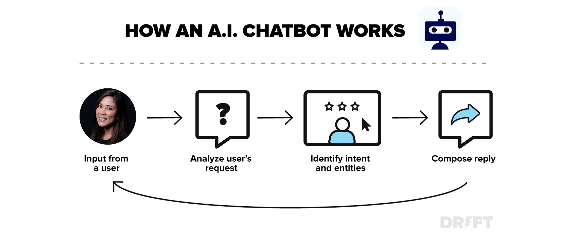

Slide 12
Examples of narrow AI:
Rankbrain by Google / Google Search
Siri by Apple, Alexa by Amazon, Cortana by Microsoft and other virtual assistants
IBM’s Watson
Image / facial recognition software
Disease mapping and prediction tools
Manufacturing and drone robots
Email spam filters / social media monitoring tools for dangerous content
Entertainment or marketing content recommendations based on watch/listen/purchase behaviour
Self-driving cars

Slide 13
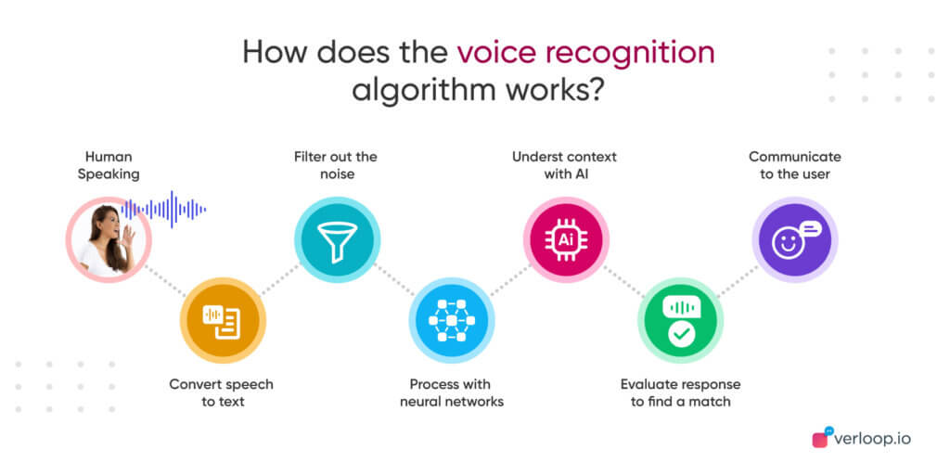

Slide 14
Artificial general intelligence (AGI), also referred to as strong AI or deep AI, is the concept of a machine with general intelligence that mimics human intelligence and/or behaviours, with the ability to learn and apply its intelligence to solve any problem. AGI can think, understand, and act in a way that is indistinguishable from that of a human in any given situation.
AI researchers and scientists have not yet achieved strong AI. To succeed, they would need to find a way to make machines conscious, programming a full set of cognitive abilities. Machines would have to take experiential learning to the next level, not just improving efficiency on singular tasks, but gaining the ability to apply experiential knowledge to a wider range of different problems.
Strong AI uses a theory of mind AI framework, which refers to the ability to discern needs, emotions, beliefs and thought processes of other intelligent entitles. Theory of mind level AI is not about replication or simulation, it’s about training machines to truly understand humans.

Slide 15
Artificial super intelligence (ASI), is the hypothetical AI that doesn’t just mimic or understand human intelligence and behavior; ASI is where machines become self-aware and surpass the capacity of human intelligence and ability.
Superintelligence has long been the muse of dystopian science fiction in which robots overrun, overthrow, and/or enslave humanity. The concept of artificial superintelligence sees AI evolve to be so akin to human emotions and experiences, that it doesn’t just understand them, it evokes emotions, needs, beliefs and desires of its own.
In addition to replicating the multi-faceted intelligence of human beings, ASI would theoretically be exceedingly better at everything we do; math, science, sports, art, medicine, hobbies, emotional relationships, everything. ASI would have a greater memory and a faster ability to process and analyse data and stimuli. Consequently, the decision-making and problem solving capabilities of super intelligent beings would be far superior than those of human beings.

Slide 16
Is AI dangerous? Will robots take over the world?
AI’s rapid growth and powerful capabilities have made many people paranoid about the “inevitability” and proximity of an AI takeover.
Mark Zuckerberg is less concerned about this hypothetical control problem, saying the positives of AI outweigh potential negatives.
Most researchers agree that superintelligent AI is unlikely to exhibit human emotions, and we have no reason to expect ASI will become malevolent. When considering how AI might become a risk, two key scenarios have been determined as most likely.
AI could be programmed to do something devastating.
Autonomous weapons are AI systems programmed to kill. In the hands of the wrong person, autonomous weapons could inadvertently lead to an AI war, and mass casualties, potentially even the end of humanity. Such weapons may be designed to be extremely difficult to “turn off”, and humans could plausibly, rapidly lose control. This risk is prevalent even with narrow AI, but grows exponentially as autonomy increases.

Slide 17
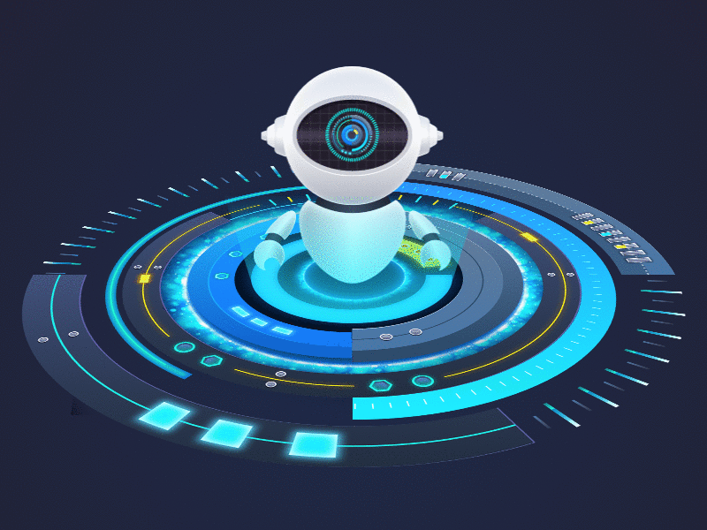
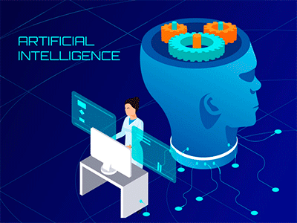
Types of AI Capabilities
Linguistic Intelligence
Musical Intelligence
Logical Mathematical Intelligence
Spatial Intelligence
Intra and Interpersonal intelligence

Slide 18
Types of AI
Cognitive Computing
Natural Language
Processing
Computer Vision
Cognitive Computing function very similarly to the workings of the human brain.
It uses computerized models to answer complex problems and requires a neuromorphic and Von Neumann model of computing.
Ex: Amazon Alexa and Apple Siri, and driverless cars.
Natural Language Processing is used to help computers understand human language.
It's ideal for processing unstructured data such as human languages, texts, and voices.
Ex: virtual assistants and chatbots to understand user queries and respond
Computer Vision is integral in recognizing photographs' key aspects, such as object detection, recognition, classification, and segmentation.
It's useful in smartphones, medical imaging, insurance, optical character recognition, 3D model building, and merging CGI with live actors in movies.
Ex: Self-driving cars.
Pedestrian detection.
Parking occupancy detection

Slide 19
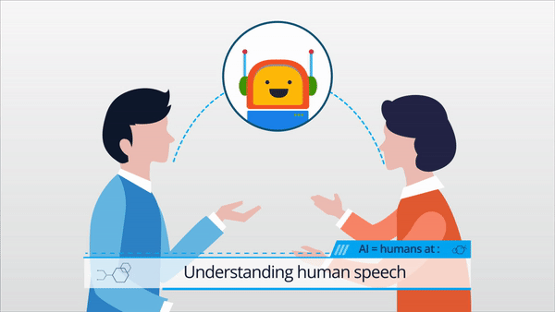
Types of AI
Linguistic Intelligence
Linguistic intelligence refers to the ability to understand, analyze, and use language effectively.
These models can comprehend context, respond to queries, translate languages, and generate coherent and contextually appropriate text.
NLP technology is employed in various applications, such as virtual assistants, chatbots, language translation, sentiment analysis, and content generation.
AI-powered language models, like GPT-3 and BERT, demonstrate linguistic intelligence by understanding and generating human language.

Slide 20
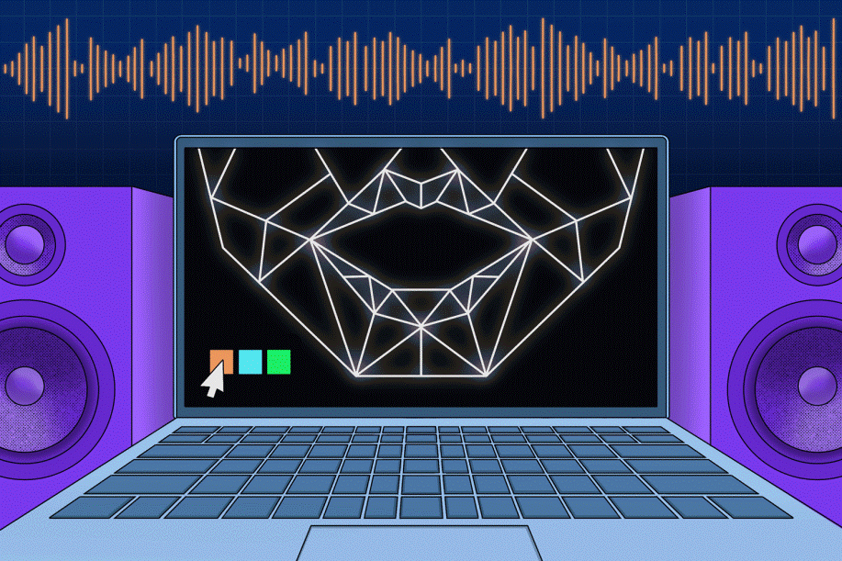
Types of AI
Musical Intelligence
AI systems can also demonstrate musical intelligence through applications like music composition, recommendation systems, and automatic music transcription.
AI algorithms can analyze and recognize musical patterns, tones, and structures, enabling them to compose new music pieces or suggest songs based on user preferences.
AI can be used in music production to mix and master audio tracks more efficiently.

Slide 21

Types of AI
Logical Mathematical Intelligence
Logical-mathematical intelligence is fundamental to the development of artificial intelligence itself.
AI algorithms rely heavily on logical reasoning, mathematical operations, and pattern recognition to solve complex problems and make informed decisions.
Machine learning models.
Example, use statistical and mathematical techniques to learn from data and make predictions.
AI is widely used in fields like finance, engineering, and scientific research, where logical and mathematical thinking is essential.

Slide 22
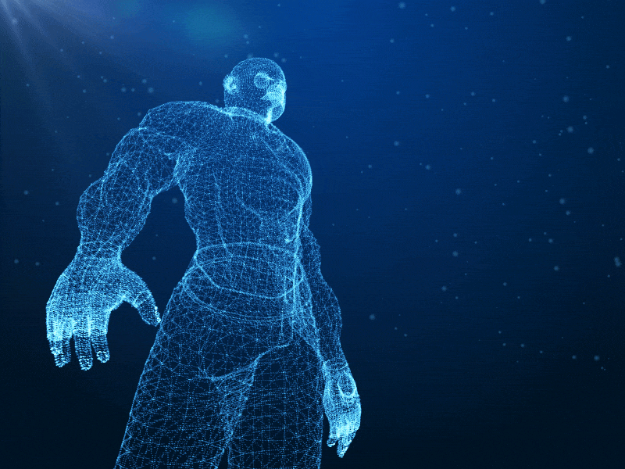
Types of AI
Spatial Intelligence in AI
Spatial intelligence is relevant in AI for computer vision applications.
AI-powered computer vision systems can interpret and process visual data, recognizing objects, scenes, and patterns in images and videos.
These systems can also perform tasks like image segmentation, object detection, and facial recognition.
Spatial intelligence in AI enables robots and autonomous vehicles to navigate their environments effectively.
Ex: Augmented reality- Can be used to make hyper-precise modifications to the perceived visual world through devices like augmented reality glasses.

Slide 23

Types of AI
Intra and Interpersonal intelligence
AI does not possess consciousness or emotions, so it does not have the same level of intra and interpersonal intelligence as humans.
However, AI can mimic some aspects of interpersonal intelligence through social AI applications like chatbots and social robots.
These AI systems can engage in conversations, recognize emotions in human speech, and respond empathetically based on pre-programmed patterns or learned behavior. But it's essential to remember that this is a simulated form of intelligence, and AI lacks genuine emotional understanding and self-awareness.

Slide 24
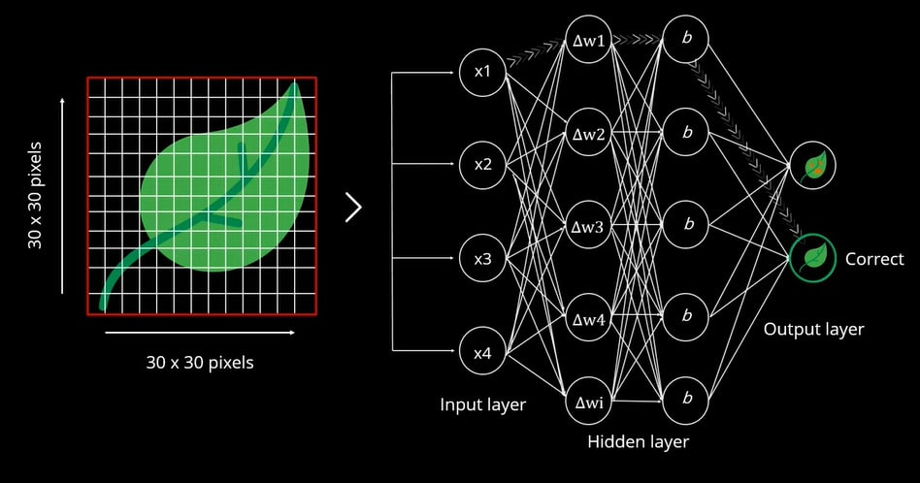
Introduction to Neural networks

Slide 25
What is Neural networks ?
Neural networks are artificial systems that were inspired by biological neural networks.
These systems learn to perform tasks by being exposed to various datasets and examples without any task-specific rules.
The idea is that the system generates identifying characteristics from the data they have been passed without being programmed with a pre-programmed understanding of these datasets.
Neural networks are based on computational models for threshold logic. Threshold logic is a combination of algorithms and mathematics.
Neural networks are based either on the study of the brain or on the application of neural networks to artificial intelligence. The work has led to improvements in finite automata theory.
More…

Slide 26
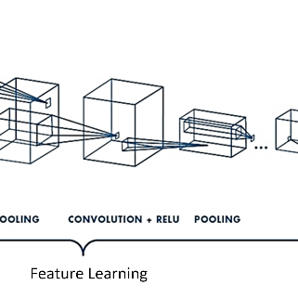
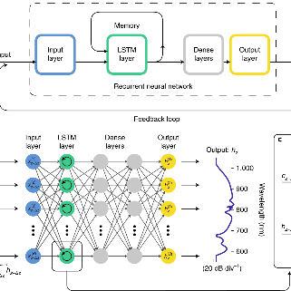
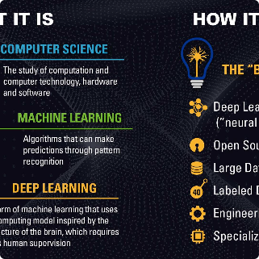
Types of Neural Networks
Convolution Neural Network (CNN)
Recurrent Neural Network (RNN)
Deep Learning
CNNs are useful for image recognition and classification, recommender systems, and natural language processing. They have convolutional layers that extract features from input data.
RNNs are effective for sequential data such as speech recognition, language modelling and music composition they have memory that remembers all information about what has been calculated and use the same parameters for each input to produce the output, reducing the complexity of parameters, unlike other neural networks.
Deep Learning is capable of processing non-linear relationships and completely based on artificial neural networks. It is used for tasks such as image recognition, speech recognition, and natural language processing.

Slide 27
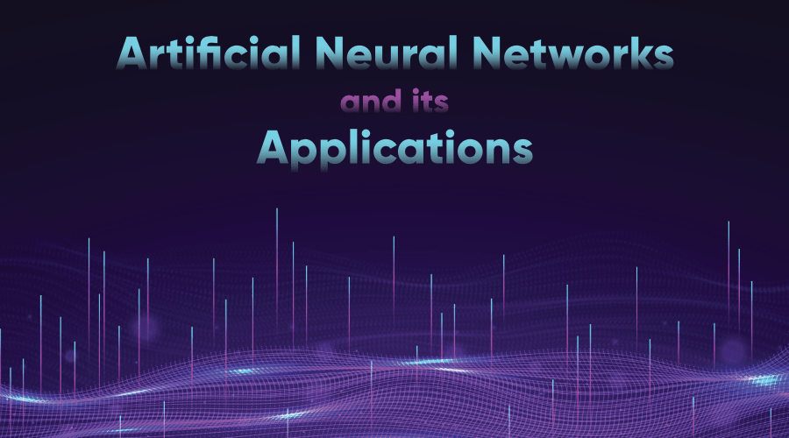
Artificial Neural Network (ANN)

Slide 28
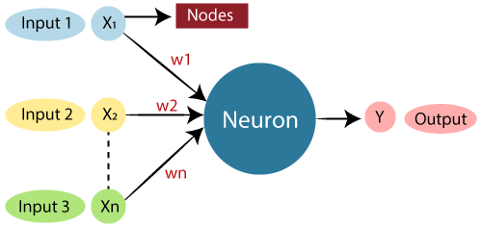

Slide 29
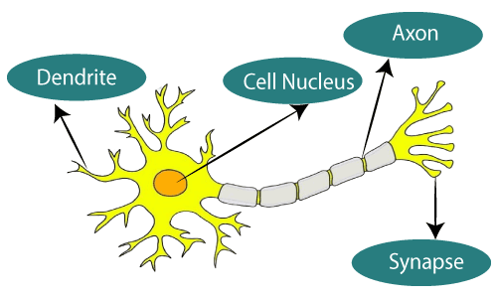

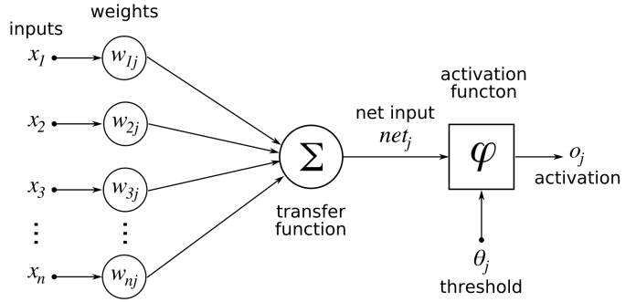
Artificial Neural Network (ANN)
An Artificial Neural Network (ANN) is an information processing paradigm that is inspired by the brain. ANNs, like people, learn by examples. An ANN is configured for a specific application, such as pattern recognition or data classification, through a learning process. Learning largely involves adjustments to the synaptic connections that exist between the neurons.
More…

Slide 30
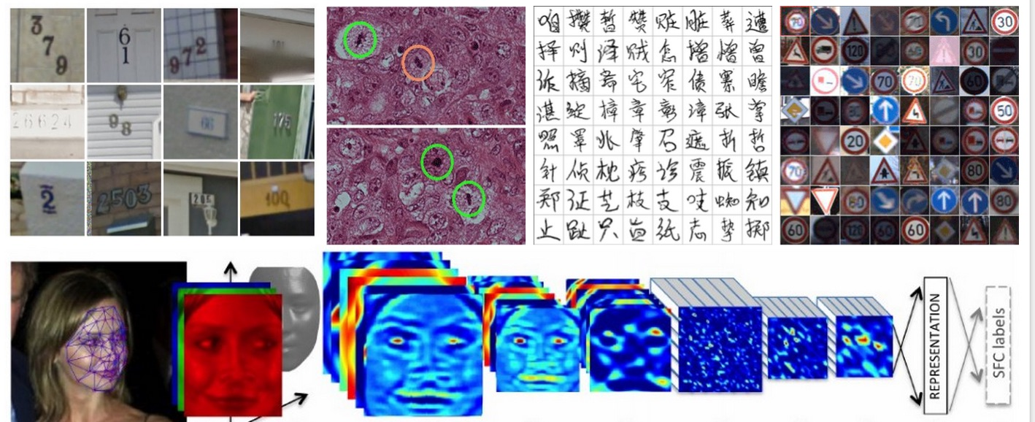
Convolution Neural Network (CNN)
Artificial Neural Networks contain artificial neurons which are called units. These units are arranged in a series of layers that together constitute the whole Artificial Neural Networks in a system.
A layer can have only a dozen units or millions of units as this depends on the complexity of the system. Commonly, Artificial Neural Network has an input layer, output layer as well as hidden layers.
The input layer receives data from the outside world which the neural network needs to analyze or learn about.
Then this data passes through one or multiple hidden layers that transform the input into data that is valuable for the output layer.
Finally, the output layer provides an output in the form of a response of the Artificial Neural Networks to input data provided.

Slide 31
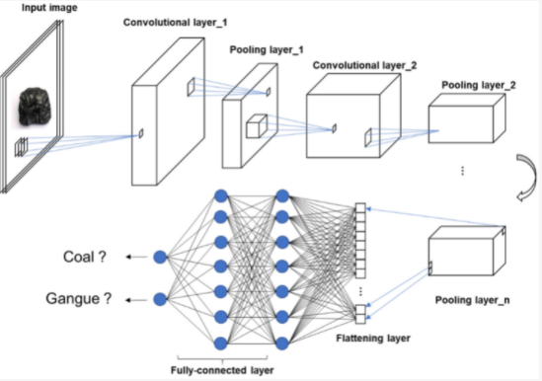

Slide 32
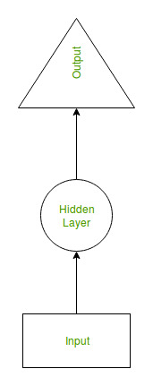
Recurrent Neural Network (RNN)
Recurrent Neural Network(RNN) are a type of Neural Network where the output from previous step are fed as input to the current step.
In traditional neural networks, all the inputs and outputs are independent of each other, but in cases like when it is required to predict the next word of a sentence, the previous words are required and hence there is a need to remember the previous words.
Thus RNN came into existence, which solved this issue with the help of a Hidden Layer.
The main and most important feature of RNN is Hidden state, which remembers some information about a sequence.

Slide 33
RNN have a “memory” which remembers all information about what has been calculated.
It uses the same parameters for each input as it performs the same task on all the inputs or hidden layers to produce the output. This reduces the complexity of parameters, unlike other neural networks.

Slide 34
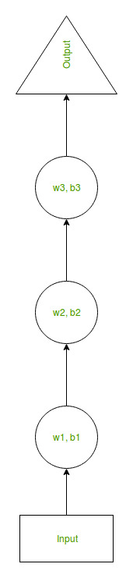
Suppose there is a deeper network with one input layer, three hidden layers and one output layer.
Then like other neural networks, each hidden layer will have its own set of weights and biases, let’s say, for hidden layer 1 the weights and biases are (w1, b1), (w2, b2) for second hidden layer and (w3, b3) for third hidden layer.
This means that each of these layers are independent of each other, i.e. they do not memorize the previous outputs.

Slide 35
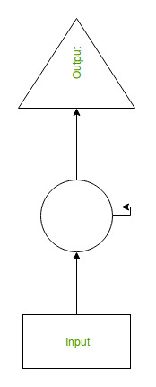
RNN converts the independent activations into dependent activations by providing the same weights and biases to all the layers, thus reducing the complexity of increasing parameters and memorizing each previous outputs by giving each output as input to the next hidden layer.
Hence these three layers can be joined together such that the weights and bias of all the hidden layers is the same, into a single recurrent layer.

Slide 36
Deep learning
Deep learning is a branch of machine learning which is completely based on artificial neural networks, as neural network is going to mimic the human brain so deep learning is also a kind of mimic of human brain.
In human brain approximately 100 billion neurons all together this is a picture of an individual neuron and each neuron is connected through thousand of their neighbors.
The question here is how do we recreate these neurons in a computer. So, we create an artificial structure called an artificial neural net where we have nodes or neurons. We have some neurons for input value and some for output value and in between, there may be lots of neurons interconnected in the hidden layer.

Slide 37
Deep Neural Network – It is a neural network with a certain level of complexity (having multiple hidden layers in between input and output layers). They are capable of modeling and processing non-linear relationships.
Deep Belief Network(DBN) – It is a class of Deep Neural Network. It is multi-layer belief networks.
Steps for performing DBN : a. Learn a layer of features from visible units using Contrastive Divergence algorithm. b. Treat activations of previously trained features as visible units and then learn features of features. c. Finally, the whole DBN is trained when the learning for the final hidden layer is achieved.
Recurrent (perform same task for every element of a sequence) Neural Network – Allows for parallel and sequential computation. Similar to the human brain (large feedback network of connected neurons). They are able to remember important things about the input they received and hence enables them to be more precise.
More

Slide 38
Difference between Machine Learning and Deep Learning :
Machine Learning | Deep Learning
Works on small amount of Dataset for accuracy. | Works on Large amount of Dataset.
Dependent on Low-end Machine. | Heavily dependent on High-end Machine.
Divides the tasks into sub-tasks, solves them individually and finally combine the results. | Solves problem end to end.
Takes less time to train. | Takes longer time to train.
Testing time may increase. | Less time to test the data.

Slide 39
Cognitive computing
Cognitive computing is a branch of computing that uses computerized models to find answers to certain complex problems just like a brain would do. Cognitive computing is basically an amalgamation of neuromorphic and Von Neumann model of computing.
In present times many devices use Artificial Neural Networking (ANN) that are used to mimic the logic the brain works on, to complete some very complicated tasks.
Although ANN is very helpful yet it has a certain limiting point. Such a scenario has given rise to a new form of computing known as Cognitive Computing.

Slide 40
Main Features of Cognitive Computing chips are-
These work in a clockless event-driven fashion leading to a decrease in energy consumption and an increase in performance.
The clockless event-driven fashion here means that unlike traditional processors where each stage of logic has to be synchronized, in cognitive computers each stage can be asynchronous where components of logic can run at different speeds completing the action more quickly.
Neuroplasticity: Cognitive computing chips are fault-tolerant and do not stop working if one of the Neurosynaptic core stops working. The neural net self-adapts and routes through other cores just like our brain does.

Slide 41
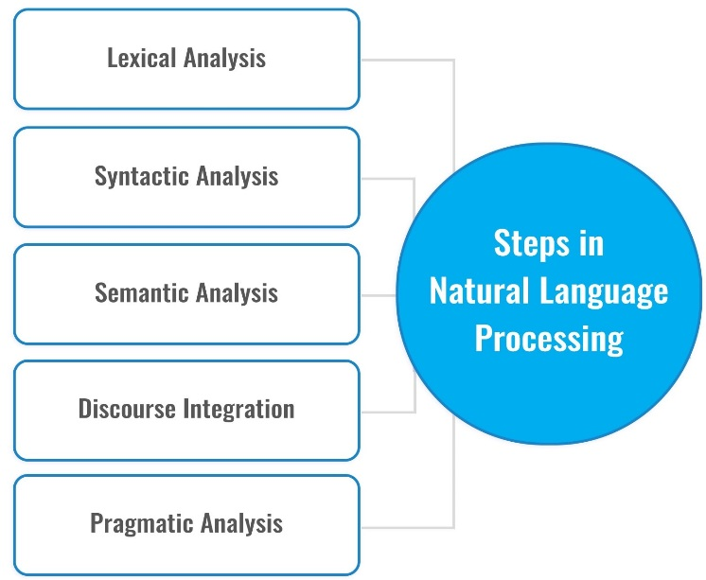
Natural Language processing
The essence of Natural Language Processing lies in making computers understand the natural language.
That’s not an easy task though. Computers can understand the structured form of data like spreadsheets and the tables in the database, but human languages, texts, and voices form an unstructured category of data, and it gets difficult for the computer to understand it, and there arises the need for Natural Language Processing.

Slide 42
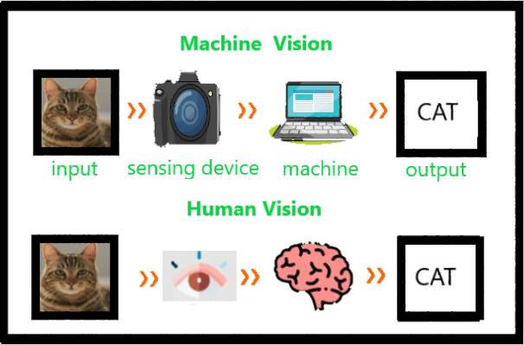
Computer vision

Slide 43
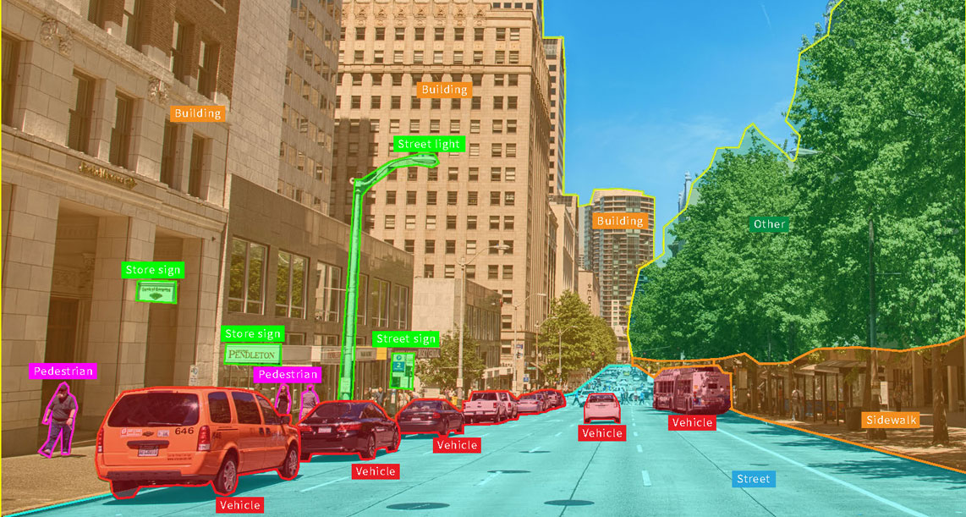
Computer vision

Slide 44
Ever wondered how are we able to understand the things we see? Like we see someone walking, whether we realize it or not, using the prerequisite knowledge, our brain understands what is happening and stores it as information.
Imagine we look at something and go completely blank. Into oblivion. Scary right? Well, the secret behind how our brain interprets the images we see has always intrigued me.
The idea to impart human intelligence and instincts to a computer seems rather effortless. Conceivably, because it is solved by very young children too, but we often tend to forget the limitations of computers as compared to our biological capabilities.
The complexity of vision perception infinitely varies and is ever dynamic in the case of human beings itself, let alone Computer intelligence.

Slide 45
Below are a few key aspects that Computer Vision seeks to recognize in the photographs:
Object Detection: The location of the object.
Object Recognition: The objects in the image, and their positions.
Object Classification: The broad category that the object lies in.
Object Segmentation: The pixels belonging to that object.

Slide 46
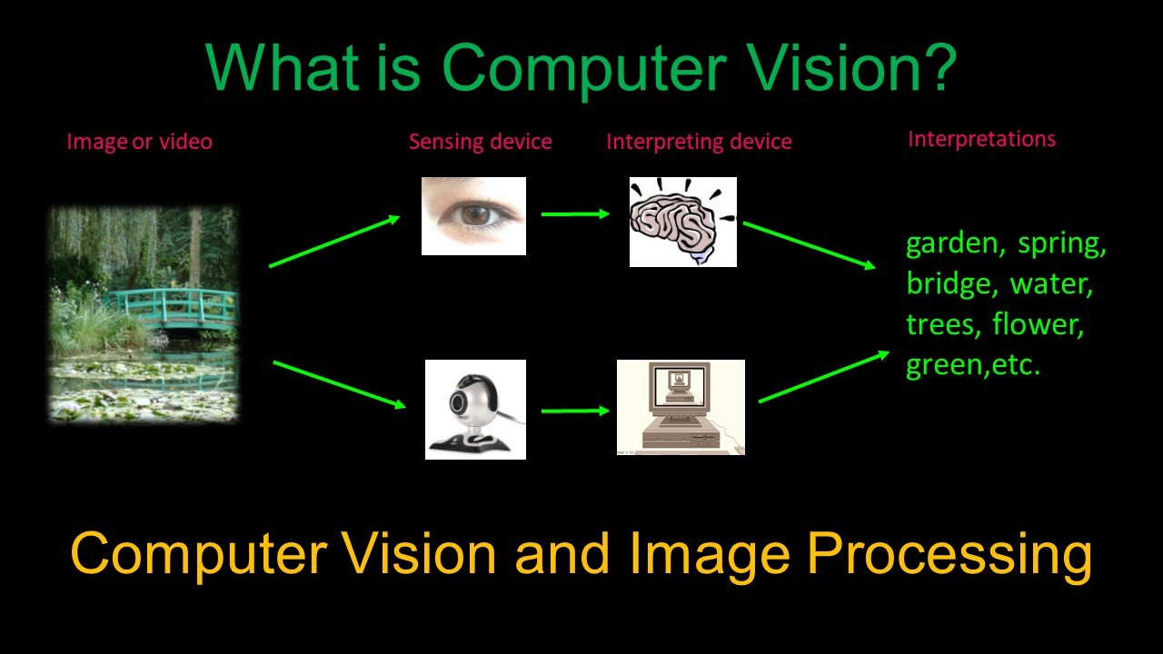
What's it to visualize?

Slide 47
Applications and Future of OpenCV
Computer Vision covers a huge ground as its applications know no bounds. It often escapes our minds as we fail to notice the role Computer Vision plays in the gadgets, we use day in and day out.
Smartphones and Web: Google Lens, QR Codes, Snapchat filters (face tracking), Night Sight, Face and Expression Detection, Lens Blur, Portrait mode, Google Photos (Face, Object and scene recognition), Google Maps (Image Stitching).
Medical Imaging: CAT/MRI
Insurance: Property Inspection and Damage analysis
Optical Character Recognition (OCR)
3D Model Building (Photogrammetry)
Merging CGI with live actors in movies

Slide 48
Role of Artificial Intelligence in Health Care
With the power to perform thousands of complex operations in a second, AI can process vast repositories of medical data into useful insights.
AI is rapidly being incorporated in different areas of medical research, and there have already been some major breakthroughs that threaten to transform the future of medicine.

Slide 49
Applications of AI in Healthcare
Robot Assisted Surgery(Da vinci):
By using AI for creating robots to assist doctors in surgery, the latest discoveries are trying to uncover the secret to minimally invasive surgeries.
Patient Experience:
From optimizing ambulance routes to waiting times using real time data, AI is working towards making healthcare more accessible and efficient for the general public.
Conversational AI is making huge progress in developing chatbots to assist patients, monitor their progress and giving health-specific alerts.

Slide 50
Drug Discovery
Integrating AI with bio-tech platforms is one of the most interesting applications of AI in healthcare today. Several pharmaceutical companies like Pfizer are applying machine learning, in search of immuno-oncology drugs. By finding patterns in medical data, and studying the outcomes of existing drugs on patients, they are trying to discover new combinations of drug ingredients for developing novel drugs.
Medical Data Analysis
With deep learning and cutting edge tools, AI is structuring medical data, to provide doctors and medical researchers with better understanding of the enormous medical data cache.

Slide 51
Radiology
AI is being used to analyze X- ray, CT and MRI scans, to diagnose medical conditions in patients. The computer vision techniques allow programs to detect abnormalities in radiology images, and have reached up to 100% accuracy on test datasets, for several diseases.
Detecting Diseases at an Earlier Stage
Machine learning played a very important role in the early predictions of medical conditions such as heart attacks and diabetes.
There are many AI-based wearables that are being developed to monitor the health of a person and display any warnings when the devices observe something unusual or unlikely.
For eg:- Fitbit and Apple watch. These devices monitor a person’s heart rate, sleep cycle, breathing rate, activity level, blood pressure, so on. It keeps the record of these measures 24×7.

Slide 52
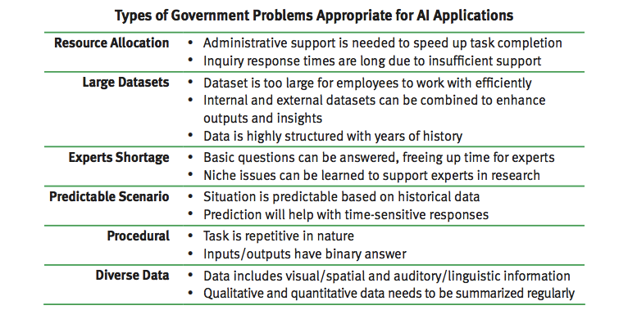

Slide 53
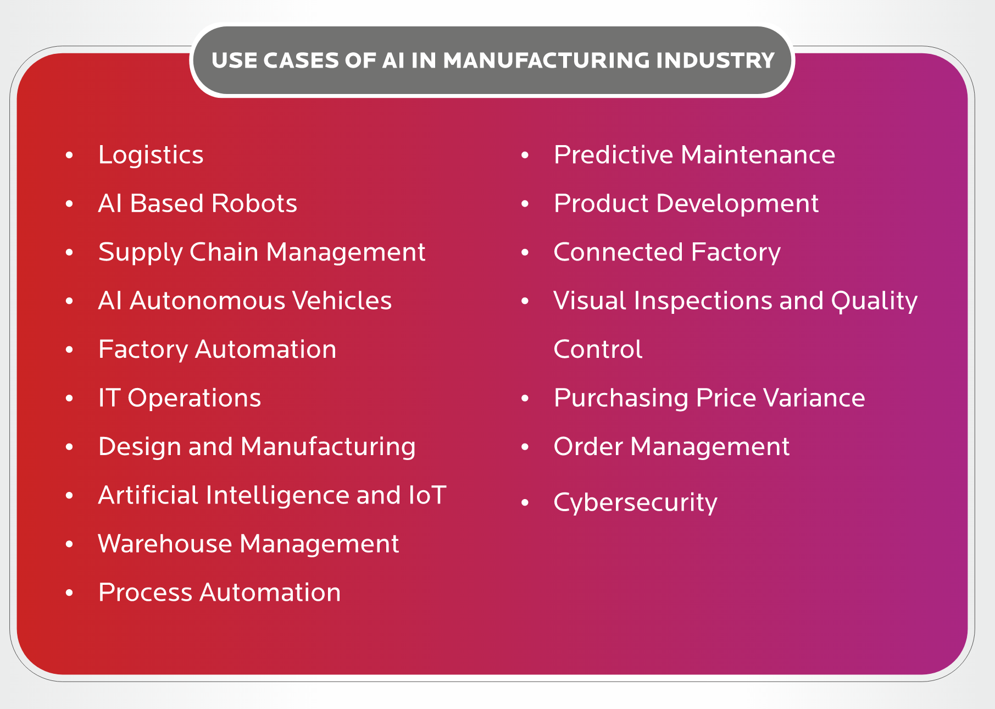

Slide 54
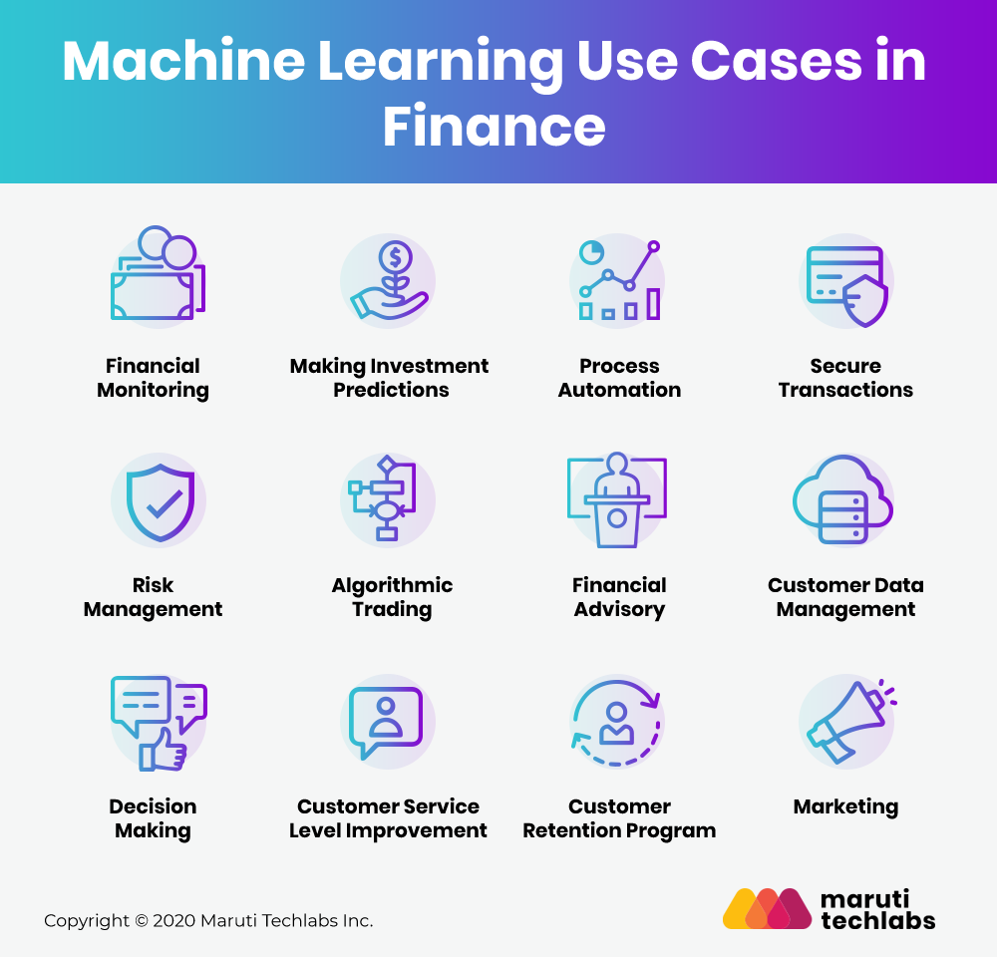

Slide 55
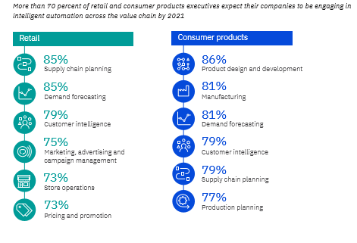

Slide 56
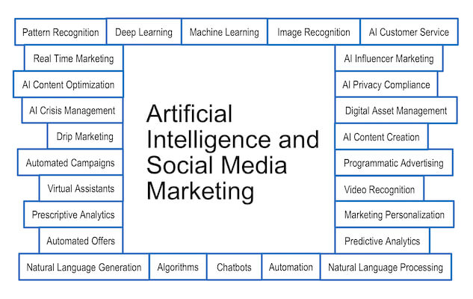

Slide 57
Thank You

